Slide 1

©2016 hermanamargarita.com

Slide 2
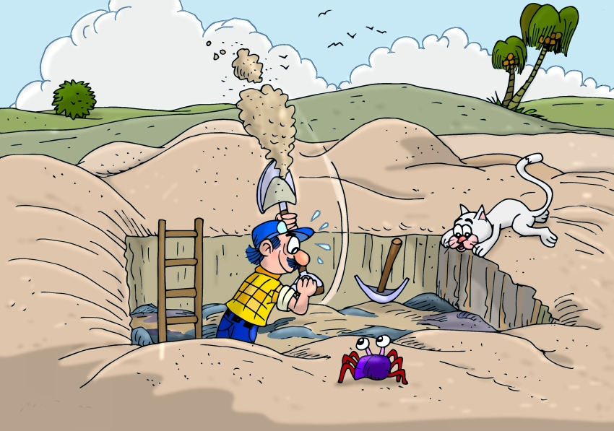
©2016 hermanamargarita.com

Slide 3
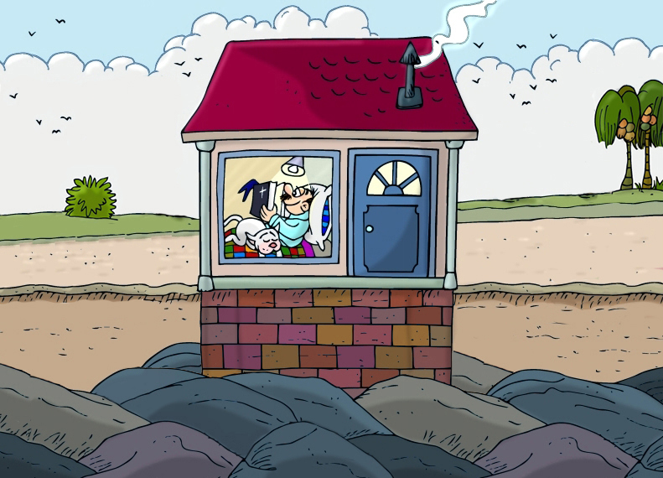
©2016 hermanamargarita.com

Slide 4
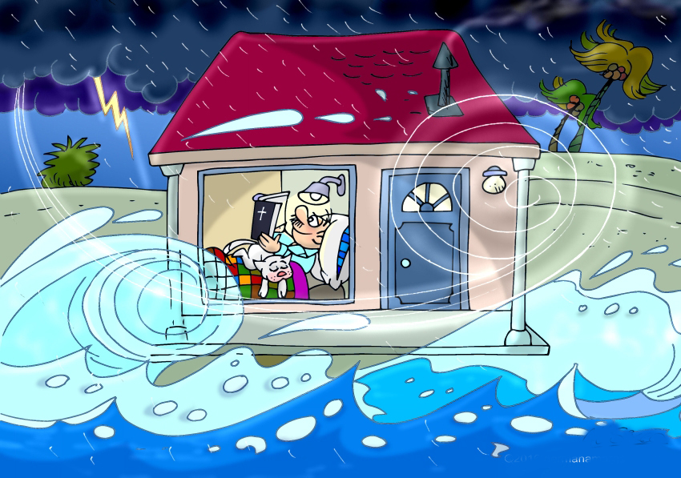
©2016 hermanamargarita.com

Slide 5
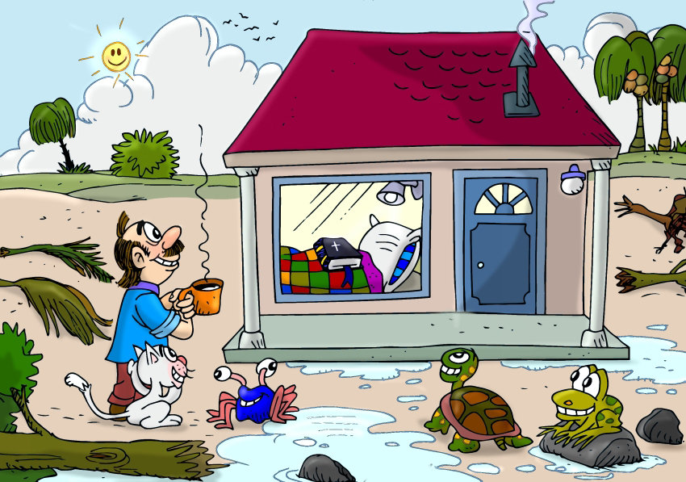
©2016 hermanamargarita.com

Slide 6
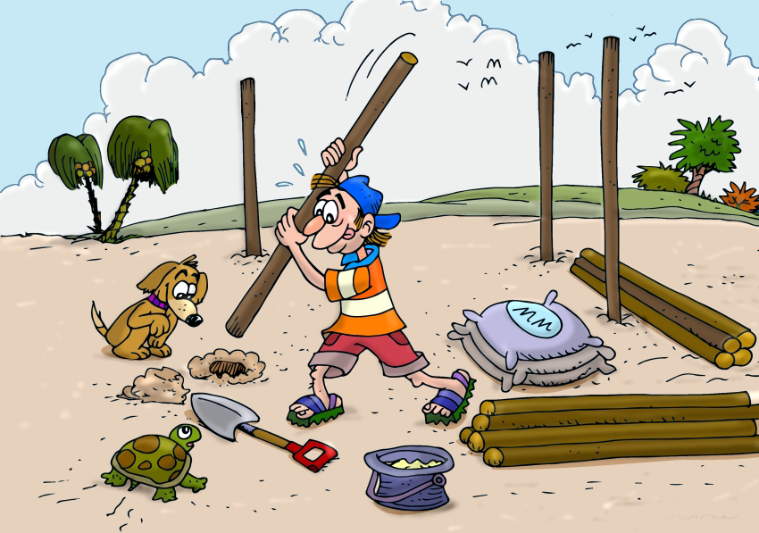
©2016 hermanamargarita.com

Slide 7
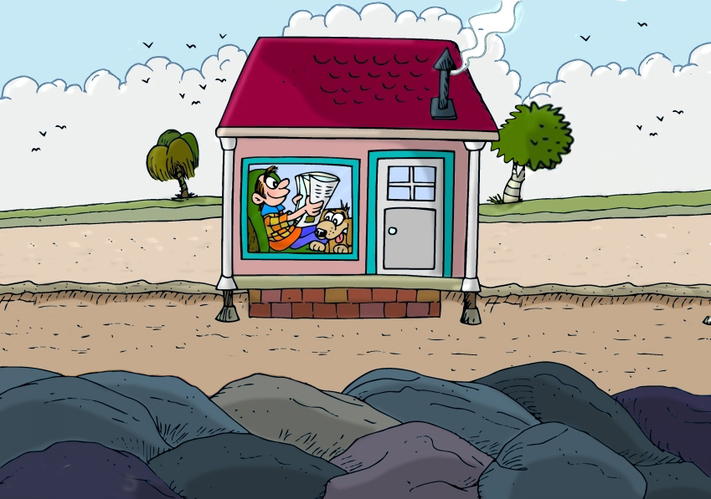
©2016 hermanamargarita.com

Slide 8
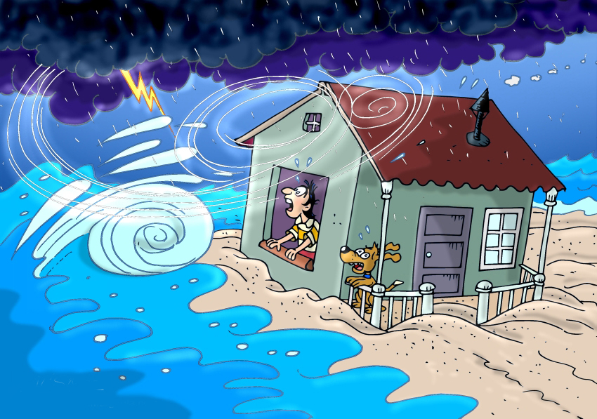
©2016 hermanamargarita.com

Slide 9
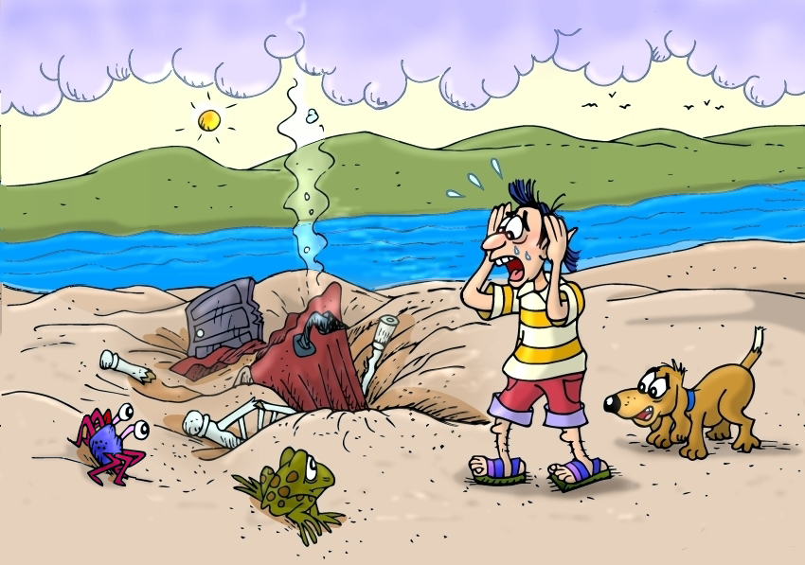
©2016 hermanamargarita.com

Slide 10


Slide 11


Slide 12


