Slide 1

1
1
2
2
3
3
4
4
Notes:
Family Feud Template
Introduction Slide – The Countdown!

Slide 2

100 CRISTIANOS DIJERON 100 CRISTIANOS DIJERON 100 CRISTIANOS DIJERON 100 CRISTIANOS DIJERON 100 CRISTIANOS DIJERON 100 CRISTIANOS DIJERON 100 CRISTIANOS DIJERON 100 CRISTIANOS DIJERON 100 CRISTIANOS DIJERON
100 CRISTIANOS DIJERON 100 CRISTIANOS DIJERON 100 CRISTIANOS DIJERON 100 CRISTIANOS DIJERON 100 CRISTIANOS DIJERON 100 CRISTIANOS DIJERON 100 CRISTIANOS DIJERON 100 CRISTIANOS DIJERON 100 CRISTIANOS DIJERON
Notes:
Fifth Grade Feud Templat
Introduction Slide – Family Feud!

Slide 3
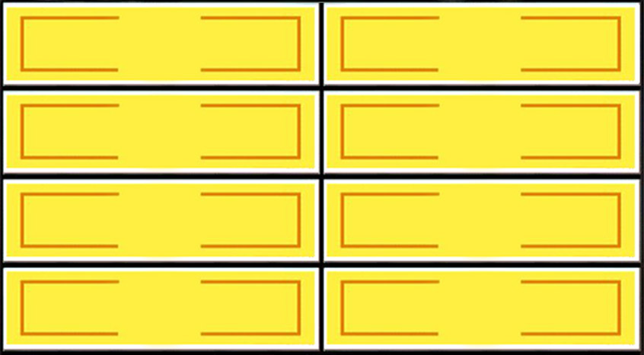







Parejas conocidas en la Biblia.
Round 1
X
X
X
X
X
X
X
X
X
Adan y Eva
35
Ester y El Rey
5
Maria y Jose
28
Abraham y Sarah
20
Jacob y Raquel
12
X
X
X
Win
Lose
Cheer
Boo
Silence
Notes:
Family Feud Template
5 Panel Slide

Slide 4

Ciudades Conocidas en la Biblia.
Round 2
X
X
X
X
X
X
X
X
X
Jerusalen
31
Belen
9
Jerico
25
Betel
3
Ninive
18
Sodoma y Gomorra
14
X
X
X
Win
Lose
Cheer
Boo
Silence
Notes:
Family Feud Template
6 Panel Slide

Slide 5

Libros que hablen del Amor.
Round 3
X
X
X
X
X
X
X
X
X
1 Corintios
40
Marcos
7
1 Juan
17
Proverbios
15
Lucas
12
X
X
X
Win
Lose
Cheer
Boo
Silence
Notes:
Family Feud Template
7 Panel Slide

Slide 6

Animales Impuros según la Biblia.
Round 4
X
X
X
X
X
X
X
X
X
Cerdo
24
Camello
11
Liebre
20
Tejon
7
Cuervo
17
Águila
14
X
X
X
Win
Lose
Cheer
Boo
Silence
Notes:
Family Feud Template
8 Panel Slide

Slide 7
Fast Money
How to use the Fast Money slide:
How to set up the board: Come up with 10 short questions with very short, definitive answers, and type those questions in the board. You will need to put the same questions in both Fast Money slides (player 1 & player 2). You will not input the answers anywhere.
To work the board: Click the 1:00 in the upper right to start the time. Click on each question to have it appear, then click on the green + if they get it right, or the red x if they get it wrong. Then manually add them up at the end. Note: The correct answer will never be revealed. The host, or the game operator needs to have the answers in front of them so that they can click + or x.
Select 2 people to play the round. They can either be 2 people from the winning team working together to get a certain number right (like the tv show) or they can be 1 from each team going head to head seeing who gets the most right. In either case, send player 2 out of the room, so they cannot hear the questions or the answers given when player 1 is answering. After player 1 has given their answers, record their score somewhere (if you’re keeping score), move to the next slide, and bring in player 2 for their turn.
If you’re keeping score: Figure out how many point each correct Fast Money answer is worth. Depending on how many rounds you play, the team’s point totals might be several hundred points off so for these Fast Money questions to possibly change the outcome, they need to be worth more than 1 point each. Perhaps you could have each correct answer worth 25 points.

Slide 8
Fast Money
1:00
0:59
0:58
0:57
0:56
0:55
0:54
0:53
0:52
0:51
0:50
0:49
0:48
0:47
0:46
0:45
0:44
0:43
0:42
0:41
0:40
0:39
0:38
0:37
0:36
0:35
0:34
0:33
0:32
0:31
0:30
0:29
0:28
0:27
0:26
0:25
0:24
0:23
0:22
0:21
0:20
0:19
0:18
0:17
0:16
0:15
0:14
0:13
0:12
0:11
0:10
0:09
0:08
0:07
0:06
0:05
0:04
0:03
0:02
0:01
End
Player 1
1:00
Cuantas preguntas puedes constestar en 1 minuto?
Question 1
1. Ciudad Nacio Jesus
+
+
x
x
Question 6
6. Cuantos libros en Biblia
+
+
x
x
Question 2
2. Mas Viejo de la Biblia
+
+
x
x
Question 7
7. Discipulo Amado
+
+
x
x
Question 3
3. Primer Hijo de David
+
+
x
x
Question 8
8. Simbolo de Promesa
+
+
x
x
Question 4
4. Monte donde oro Jesús
+
+
x
x
Question 9
9. Primer milagro de Jesus
+
+
x
x
Question 5
5. Se convirtio en sal
+
+
x
x
Question 10
10. Deatrozo al Leon
+
+
x
x
Win
Lose
Cheer
Boo
Silence
Notes:
Answers: 1. Belen 2. Matusalén 3. Amnón 4. Monte de los Olivos 5. Esposa de Lot 6. “66” libros 7. Juan 8. Arcoiris 9. Agua en Vino 10. Samson

Slide 9
Fast Money
1:00
0:59
0:58
0:57
0:56
0:55
0:54
0:53
0:52
0:51
0:50
0:49
0:48
0:47
0:46
0:45
0:44
0:43
0:42
0:41
0:40
0:39
0:38
0:37
0:36
0:35
0:34
0:33
0:32
0:31
0:30
0:29
0:28
0:27
0:26
0:25
0:24
0:23
0:22
0:21
0:20
0:19
0:18
0:17
0:16
0:15
0:14
0:13
0:12
0:11
0:10
0:09
0:08
0:07
0:06
0:05
0:04
0:03
0:02
0:01
End
Player 2
1:00
How many can you get right in 1 minute?
Question 1
1.
+
+
x
x
Question 6
6.
+
+
x
x
Question 2
2..
+
+
x
x
Question 7
7.
+
+
x
x
Question 3
3.
+
+
x
x
Question 8
8.
+
+
x
x
Question 4
4.
+
+
x
x
Question 9
9.
+
+
x
x
Question 5
5.
+
+
x
x
Question 10
10.
+
+
x
x
Win
Lose
Cheer
Boo
Silence
Notes:
Answers: 1. Sacramento 2. Missouri River 3. Alaska 4. Hawaii 5. Hawaii 6. Simbolo de Promesa 7. Philadelphia 8. New York 9. Washington D.C. 10. Boise

