Slide 1


Slide 2

^{©2017 hermanamargarita.com}

Slide 3
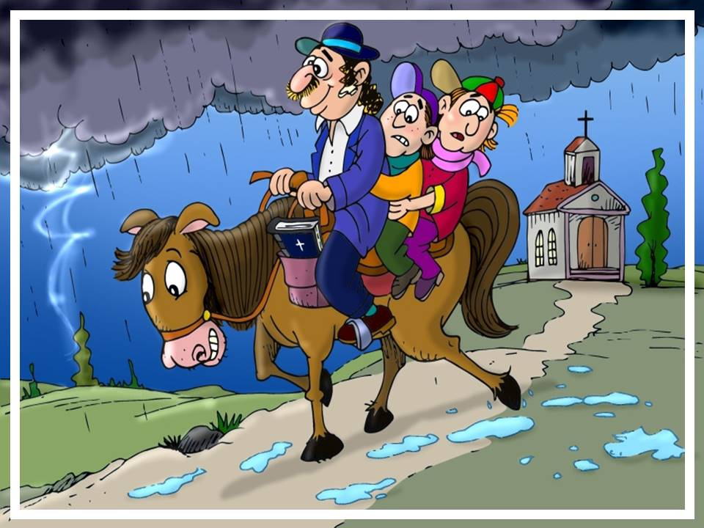
^{©2017 hermanamargarita.com}

Slide 4
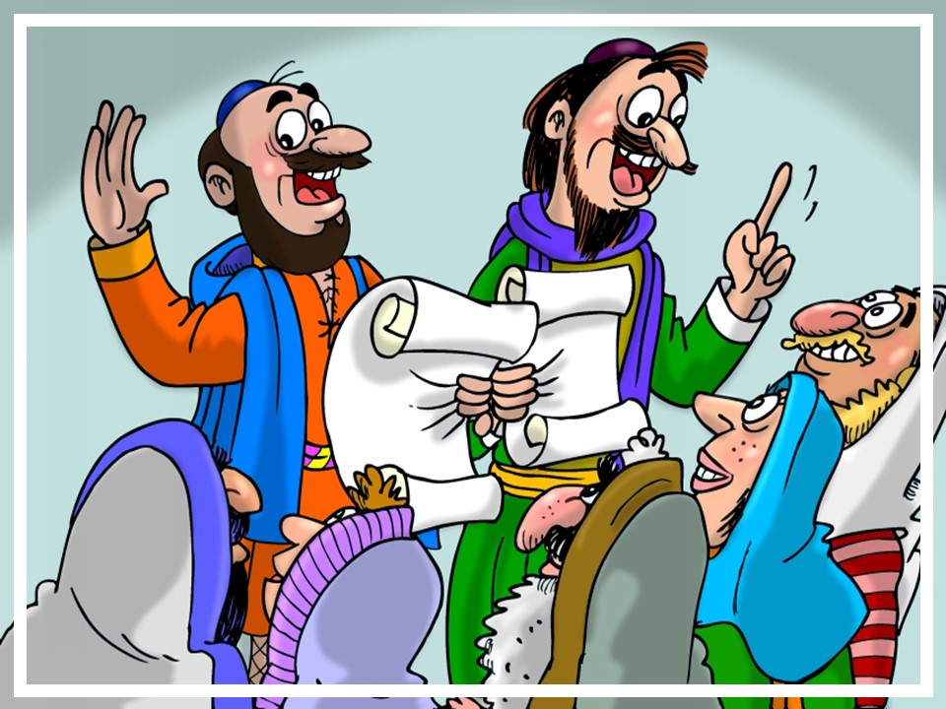
^{©2017 hermanamargarita.com}

Slide 5
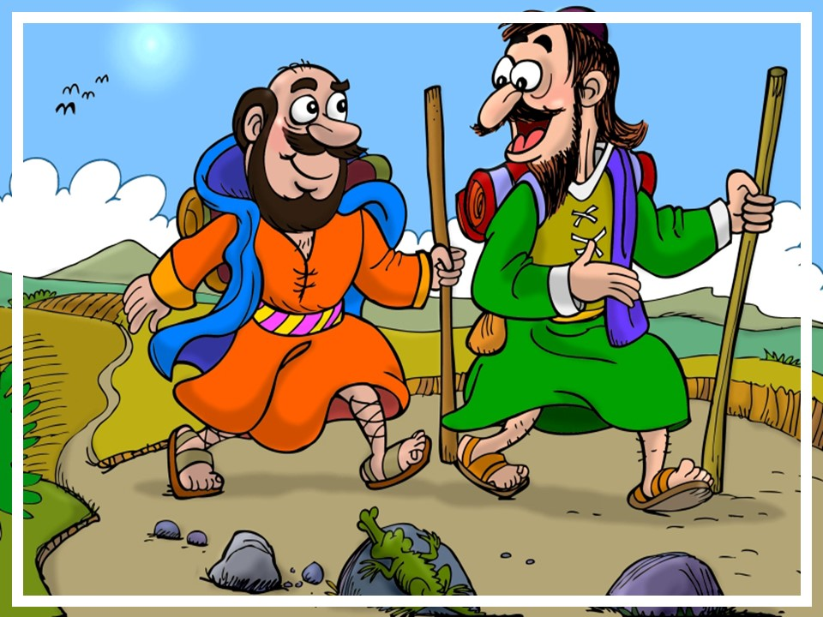
^{©2017 hermanamargarita.com}

Slide 6
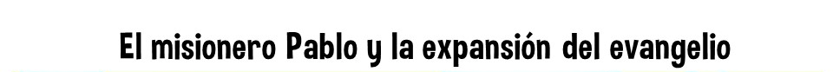
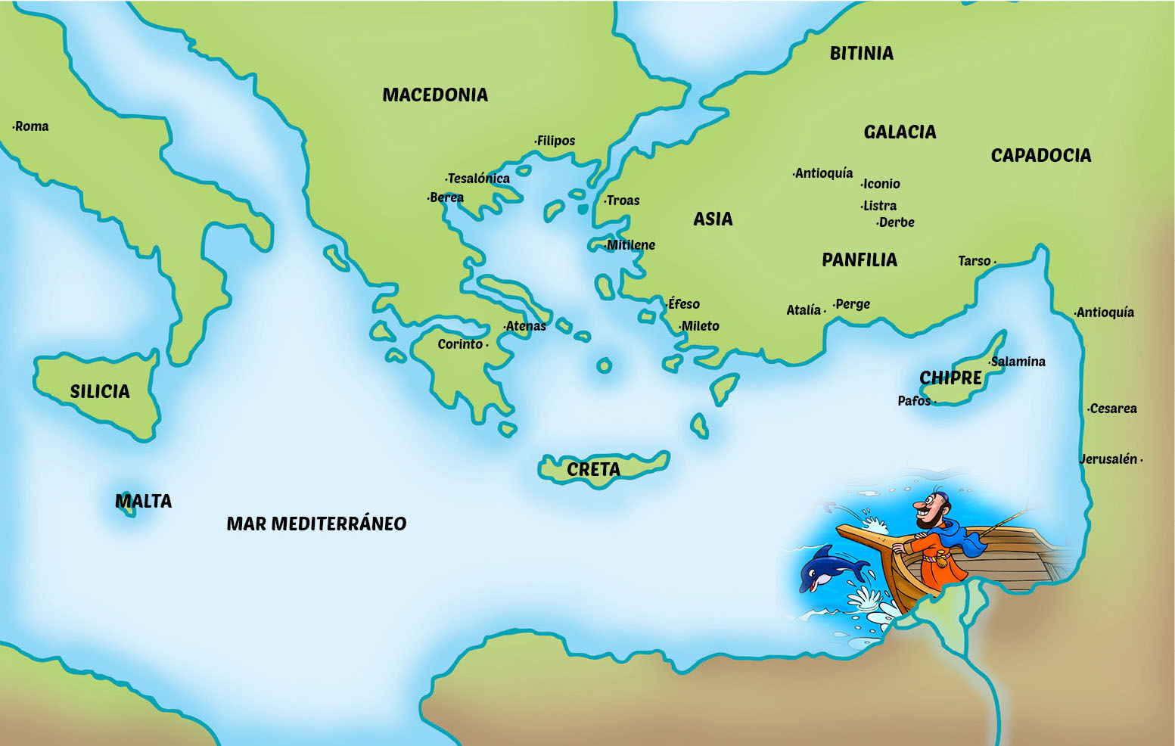
^{©2017 hermanamargarita.com}

Slide 7
^{©2017 hermanamargarita.com}

Slide 8


