Slide 1


Slide 2
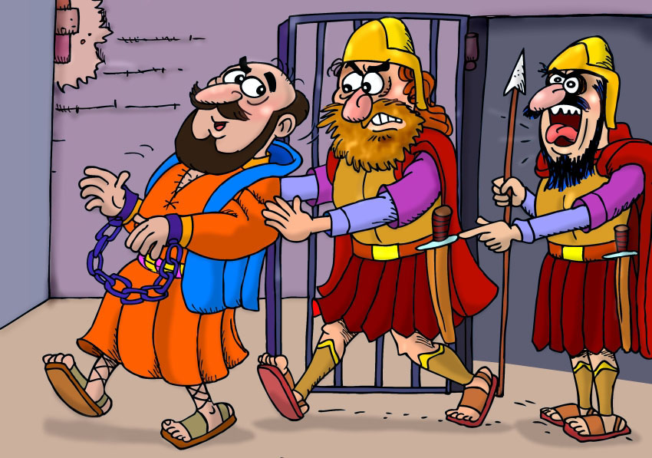
^{©2017 hermanamargarita.com}
^{©2017 hermanamargarita.com}

Slide 3
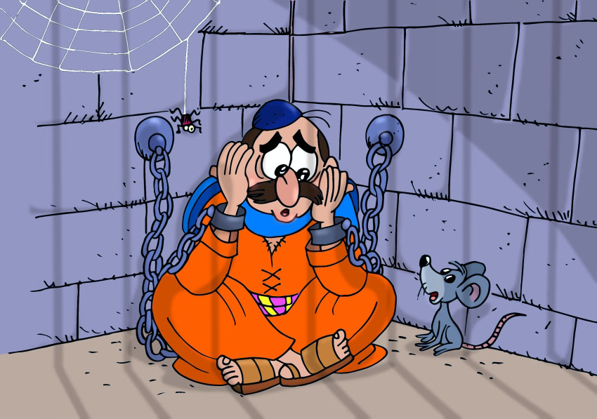
^{©2017 hermanamargarita.com}
^{©2017 hermanamargarita.com}

Slide 4
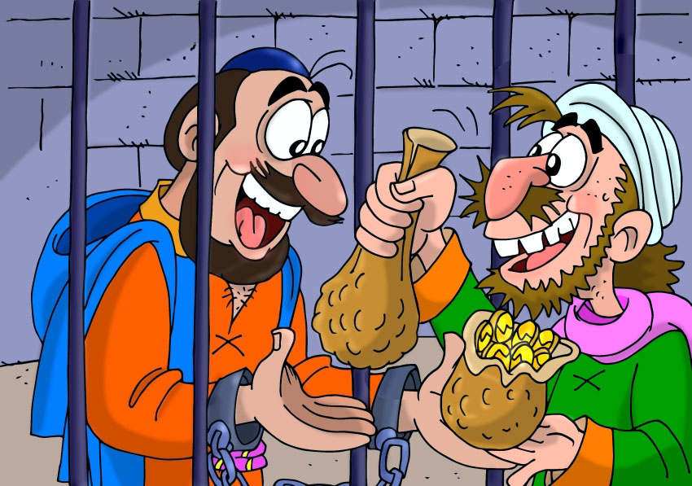
^{©2017 hermanamargarita.com}
^{©2017 hermanamargarita.com}

Slide 5


