Slide 2
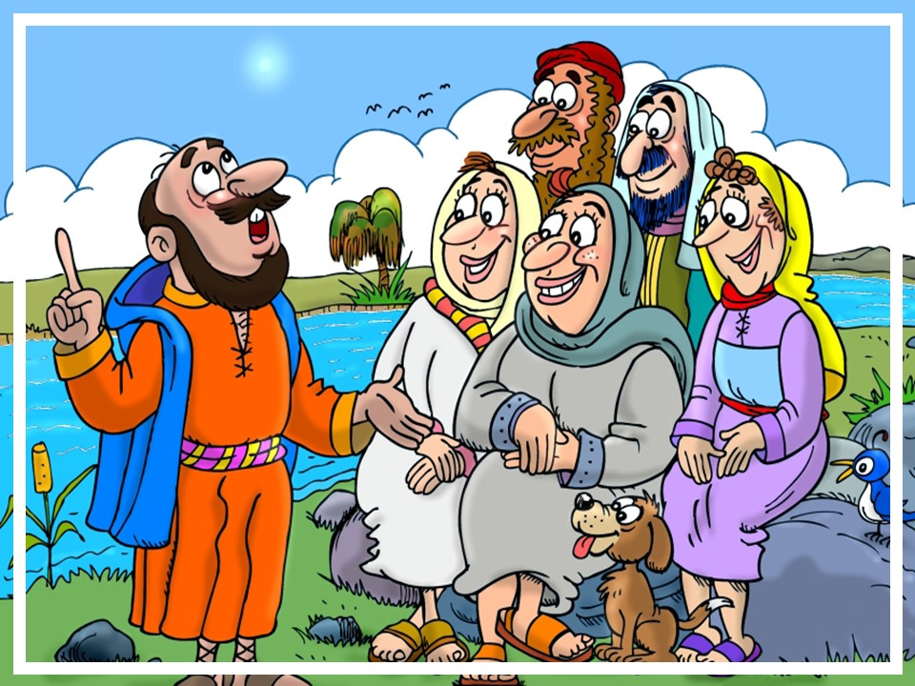
^{©2017 hermanamargarita.com}

Slide 3
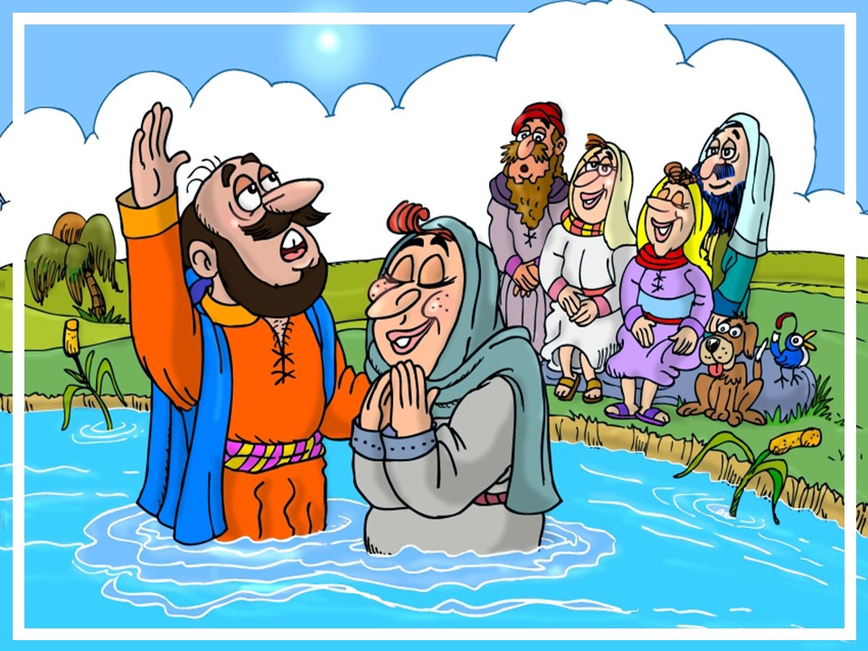
^{©2017 hermanamargarita.com}

Slide 4
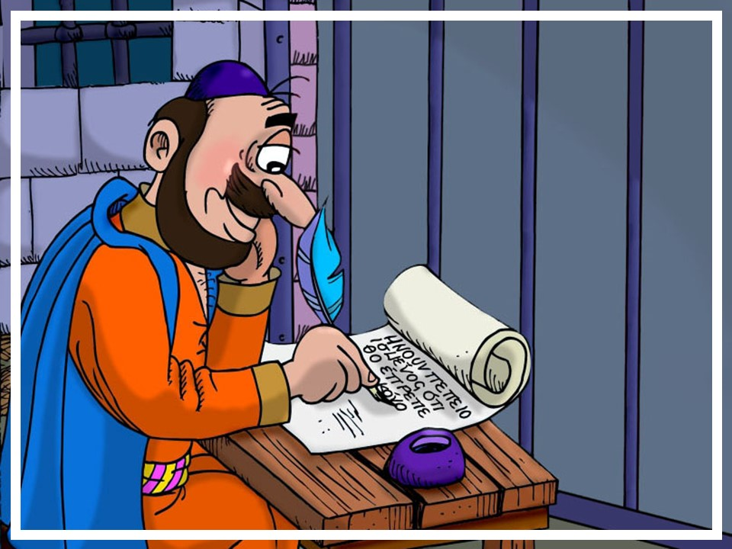
^{©2017 hermanamargarita.com}

Slide 5
^{©2017 hermanamargarita.com}

Slide 6
^{©2017 hermanamargarita.com}

Slide 7
^{©2017 hermanamargarita.com}

